Slide 1
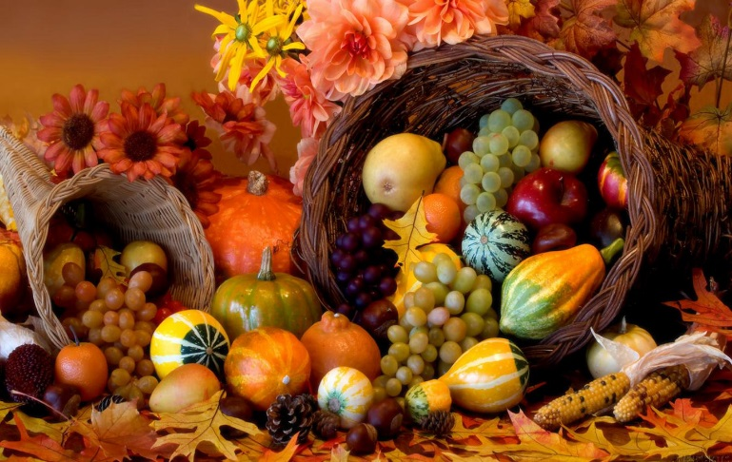
Happy Monday! Independent Silent Reading

Slide 2
Elements of a Short Story
Copy the slides when you see the spider

Slide 3
Elements of a Short Story
Character
Setting
Plot
Point of View/Foreshadowing/Flashback
Irony
Theme

Slide 4
4. Foreshadowing
When an author mentions or hints at something that will happen later in the plot. It is often used to build suspense or tension in a story.

Slide 5
Try breaking the word FORESHADOWING apart.
FORE means ahead
A SHADOW is a glimpse of something without the complete details

Slide 6
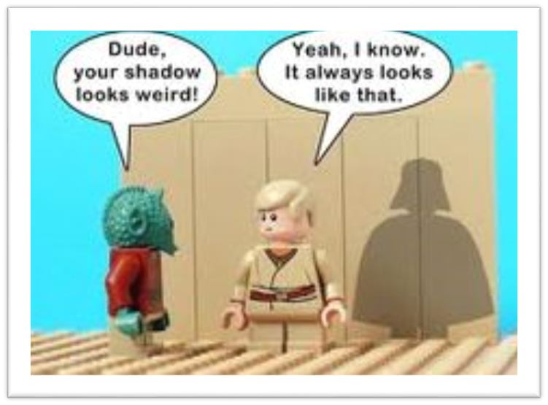

Slide 7
Flashback
When an author refers back to something that already took place in the story.

Slide 8
Now try breaking the word FLASHBACK apart.
FLASH means a quick glimpse
BACK as in a look back in the story at something that previously happened

Slide 9
Little Red Riding Hood
Notes:
The Goldbergs is told in First Person: https://www.youtube.com/watch?v=sB3-c2B2h2k
Another example would be “The Wonder Years” The narrator tells the story: https://www.youtube.com/watch?v=MiVoMO-FFME

Slide 10
Once upon a time, there was a little girl who lived with her mother. Her mother asked her to take her old and lonely grandmother some food one day. "Don't stop along the way. Go straight to your Grandma's house and back. Don't talk to any strangers and watch out for the wolf in the woods! Now get along!"

Slide 11
Once upon a time, there was a little girl who lived with her mother. Her mother asked her to take her old and lonely grandmother some food one day. "Don't stop along the way. Go straight to your Grandma's house and back. Don't talk to any strangers and watch out for the wolf in the woods! Now get along!"
Foreshadowing

Slide 12
The set of orange colored words is an example of foreshadowing.
Little Red Riding Hood’s mother is warning her about the wolf in the woods, which hints at what may happen next.

Slide 13
While she was walking through the woods, a wolf was walking past her. "I bet I could convince her to take the long way. Then I could get to her grandmother's house first and trick her into thinking that I was her grandma. That way I could have her and her grandma for a large feast,” he thought.

Slide 14
The wolf went up to Little Red Riding Hood and told her that he knew a shortcut. Little Red Riding Hood thought back to what her mother told her. “Don’t talk to any strangers and watch out for the wolf in the woods!” But it was too late, she had already listened to the wolf’s directions.

Slide 15
The wolf went up to Little Red Riding Hood and told her that he knew a shortcut. Little Red Riding Hood thought back to what her mother told her. “Don’t talk to any strangers and watch out for the wolf in the woods!” But it was too late, she had already listened to the wolf’s directions.
Flashback

Slide 16
The set of blue colored words is an example of flashback.
Little Red Riding Hood is thinking back to something that happened earlier in the story.

Slide 17
Review

Slide 18
When an author mentions or hints at something that will happen later in the story, it is called foreshadowing.
Foreshadowing

Slide 19
When an author refers back to something that has already happened in the story, it is called flashback.
Flashback

Slide 20
Flashback in Movies

Slide 21
What does the flashback tell us about the character/story?
Notes:
Pixar’s Up

Slide 22
Foreshadowing in Movies

Slide 23
While watching the clip, try to identify four examples of foreshadowing.
Notes:
Pixar’s Up

Slide 24
Foreshadowing or Flashback?

Slide 25
Foreshadowing or Flashback?
"You're getting it. Good girl!" Anya cheered as she ran beside her little sister. Anya smiled, remembering when her dad had taught her to ride a bike. She could still see him running beside her, even when he didn't need to anymore! He'd always been so protective. But now, he was gone and she alone had to take care of the family. "I still need you, Dad," she whispered.
Notes:
Flashback - remembering

Slide 26
Foreshadowing or Flashback?
I looked at the speedometer… Paul was driving even faster. "Please slow down," I said. "We're coming to a really bad curve in the road!" But he didn't slow down and the snow was drifting higher and higher. I could hardly see the road!
Notes:
Foreshadowing – curve in the road, snow drifting higher and higher, hardly see the road

Slide 27
Foreshadowing or Flashback?
"It's going to be one of those days," Marek thought to himself as he looked up at the board labeled DEPARTURES. His flight was delayed. He thought back to how the day had begun. When he woke up, the sun had been shining brightly and robins that had built a nest outside his window were chirping loudly. He'd jumped out of bed, anxious to start the first day of his vacation. But he'd tripped over the clothes he'd carelessly dropped on the floor the night before and banged his knee on the closet door.

Slide 28
Foreshadowing or Flashback?
When he was finished, Marek went to look for something to eat. He thought about the last time he'd gone on vacation with both Mom and Dad. They'd gone to that new theme park and had a great time. That had been the last time Dad had taken any real time off… Mom insisted he worked too much. Then things changed, and now he was caught between two homes … the one he shared with Mom and the one we visited to see Dad.

Slide 29
Exit Slip

Slide 30
On your slip of paper, answer these 4 questions:
1. A hint about what is to come in the story is called
Foreshadowing
Flashback
2. A writing technique that describes events in the past is called
Foreshadowing
Flashback
3. “All of a sudden, Rory remembered an incident from long ago. He had been walking in the woods when his brother tried to scare him by wearing a ghost costume.” This is an example of
Foreshadowing
Flashback
4. “I’m not sure about that bridge. It looks like it may collapse at any moment.” This is an example of
Foreshadowing
Flashback
Don’t forget your name!

