Slide 1
Elements of a Short Story
English 9

Slide 2
Elements of a Short Story
Character
Setting
Plot
Point of View / Foreshadowing
Irony
Theme
Notes:
Monday

Slide 3
1. Characters(Copy)
1. Character Traits: are the qualities of a certain person, whether they are physical or emotional. You determine some traits by observing the way a character looks. You observe other traits by paying attention to the way the character behaves.
Notes:
Monday

Slide 4
Some Examples
Jesse had no idea how deep the river was. He just jumped.
Trait: reckless
Amanda had no idea why everyone else was laughing as she strolled around the room in mismatched shoes.
Trait: clueless
Susan jumped every time the door opened.
Trait: jittery
Notes:
Monday

Slide 5
1. Characters(Copy)
There are six terms we will use to define and describe characters. They are:
2. Protagonist: The main character(s) in the story. He/she always faces a conflict.
3. Antagonist: The character(s) or force that is in conflict with the protagonist. In some cases, this might not even be a living thing.
Notes:
Monday

Slide 6
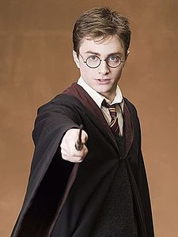
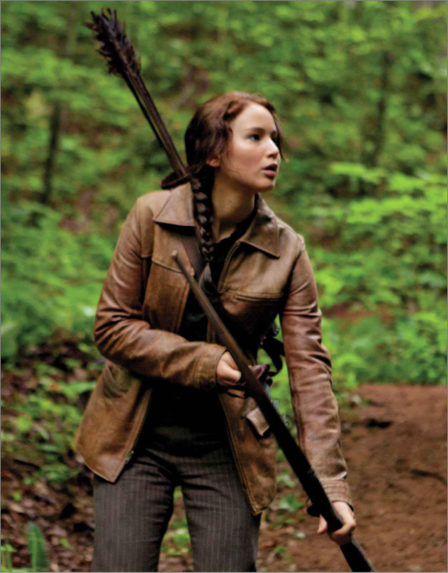
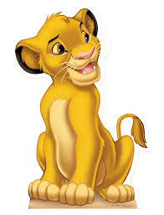
Protagonist = Main Character
Some Examples:
Notes:
Monday

Slide 7
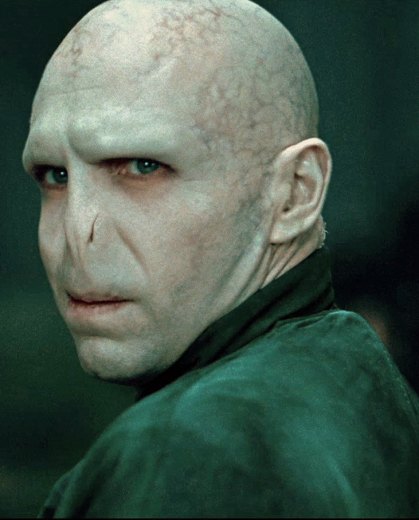
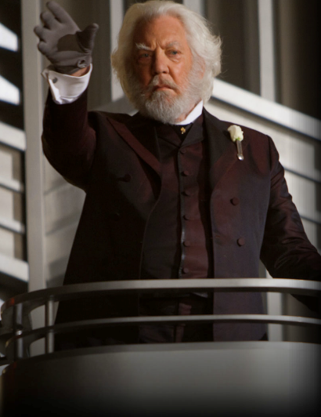
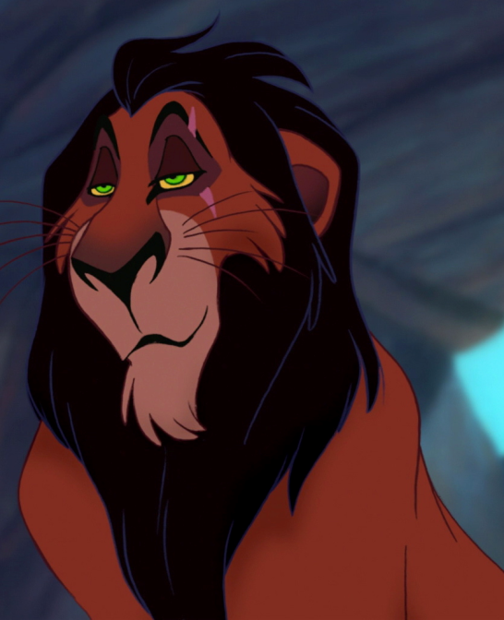
Antagonist = Protagonist’s conflict
Some Examples:
Notes:
Monday

Slide 8
1. Characters(Copy)
4. Round: Fully developed characters who are complex and realistic. The reader is exposed to different sides of their personality, lifestyle, and interests. Clear and realistic character traits.
5. Flat: Characters who are less developed (often stereotypical) – they are usually minor characters and less realistic.
Notes:
Tuesday

Slide 9
1. Characters(Copy)
6. Dynamic: A character who undergoes a change in personality. He/she is affected by the events, and it has changed his/her personality, behavior, or perspective on life.
7. Static: A character whose personality remains the same throughout the story. He/she is unchanged by the events that have happened.
Notes:
Tuesday

Slide 10
On the Sidewalk Bleeding
Read “On the Sidewalk Bleeding” Crossroads 9 –Page 35
Notes:
Monday

Slide 11
Paragraphs

Slide 12
Review
We will be doing a quick review on character, paragraphs and, topic sentences.
Notes:
Thursday

Slide 13
Paragraphs
You must have a clear idea of what the paragraph is going to be about.
This is because a paragraph is essentially a collection of sentences which all relate to one central topic.
Without a definite idea of what the main topic is, your paragraph will lack focus and unity.
Notes:
Tuesday

Slide 14
Notes:
Tuesday and Wednesday

Slide 15
Topic Sentences
What is the topic sentence? The topic sentence is the first sentence in a paragraph.
What does it do? It introduces the main idea of the paragraph.
How do I write one? Summarize the main idea of your paragraph. Indicate to the reader what your paragraph will be about. GRAB THE READERS ATTENTION!
Notes:
Wednesday

Slide 16
Two Parts
Topic sentences are usually made of two parts.
One part is the topic.
The other part is the controlling idea.
The controlling idea limits what you will say about the topic. Both parts are needed if you want to make a good topic sentence

