Slide 1
Research
Tips and Tricks!

Slide 2
First Steps
Google
Google Scholar
EBSCO Host
Wikipedia

Slide 3
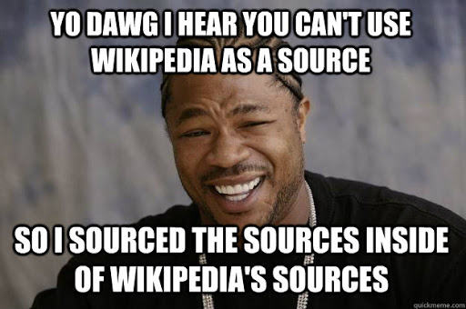
Using Wikipedia
Basic Information
Check the security of the page
References can give you sources to explore
Why is Wikipedia reliable?
Neutral Point of View
No Original Research
Verifiability

Slide 4
Red Flags for Unreliable Websites
How do YOU know if something is fake or questionable?

Slide 5
Red Flags for Unreliable Websites
ALL CAPS, or obviously photoshopped pictures
A lot of popups and banner ads
Check the domain (.com, .ca…) .co is questionable
Read a website’s “About” page. Google it with the word “fake” and see what comes up
No links, quotes, or references
See is an unlikely story is true by finding the topic on a trustworthy website.
Check the date!

Slide 6
If you are not sure if a source is reliable, don’t use it!

