Slide 2
Before we can learn about sentence structure, we must know these key terms!
Subject
Predicate
Conjunction
Independent clause
Dependent clause

Slide 3
Subject – the topic of a sentence
Predicate – the action word in the sentence
Conjunction – a part of speech that links together words and phrases
EXAMPLE
The dog chased a ball.
The subject is what or who the sentence is about. The predicate is the action in which the subject completes.
subject
predicate

Slide 4
Subject – the topic of a sentence
Predicate – the action the subject completes
Conjunction – a part of speech that links together words and phrases
EXAMPLE
The dog chased a ball, and the cat slept.
subject
predicate
C
subject
predicate

Slide 5
EXAMPLES
The dog and cat chased a ball.
My brother ate the candy and drank the juice.
compound subject
predicate
subject
compound predicate

Slide 6
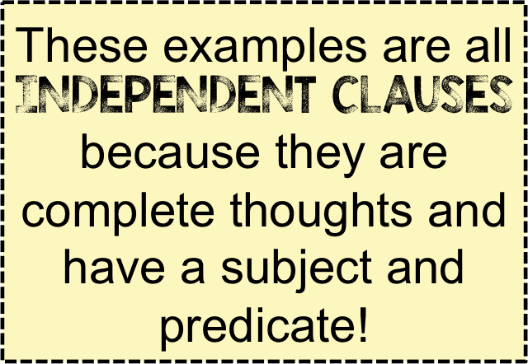
YOUR TURN: identify the subject & predicate.
Five small cats slept on the windowsill.
He won!
Amanda loves to swim.
subject
predicate
S
P
subject
predicate

Slide 7
YOUR TURN: identify the subject & predicate.
Mae and Anna went to the store to buy flowers.
He won, but he forgot to claim the prize!
Amanda and Luke play soccer and golf.
compound subject
predicate
S
P
C
S
predicate
compound subject
compound predicate

Slide 8
Independent clause – a group of words with one subject and one predicate that form a complete thought.
EXAMPLES
She rode her bike to town.
The teacher graded the tests.
Three ducks swam in a pond and splashed.
Enrique and Emily studied in the library.

Slide 9
EXAMPLES
She rode her bike to town.
The teacher graded the tests.
Three ducks swam in a pond and splashed.
Enrique and Emily studied in the library.
S
predicate
subject
predicate
subject
compound predicate
compound subject
predicate

Slide 10
Dependent clause – a groups of words with a subject and predicate that do not form a complete thought; this is not a sentence
Dependent clauses are typically indicated by a marker word.
DEPENDENT CLAUSE MARKER WORDS
after, although, as, because, before, even, if, even though, if, in order to, since, though, unless, until, when, whenever, whether, while

Slide 11
Dependent clause – a group of words with one subject and one predicate that form a complete thought; this is a complete sentence
EXAMPLE
When she rode her bike to town…
marker
S
predicate
NOTICE: This clause is not a complete thought.

Slide 12
YOUR TURN – identify the marker word, subject, and predicate
Although he prefers to cook Italian food…
Before she did all of her homework…
marker
S
predicate
marker
S
predicate

