Slide 1
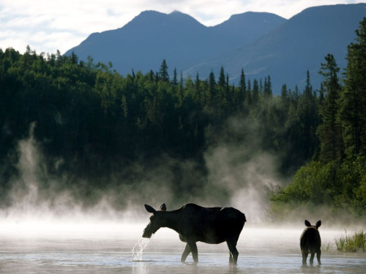
Happy Monday! Independent Silent Reading

Slide 2
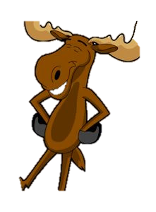
Elements of a Short Story
Copy the slides when you see the happy moose

Slide 3
Elements of a Short Story
Character
Setting
Plot
Point of View / Foreshadowing
Irony
Theme

Slide 4
2. Setting
Setting is the time and location in a story. There are
four aspects to it:
a) Place
- Where it takes place and how is this significant?
b) Time
- When it takes place (day, month, season, etc.)

Slide 5
c) Weather conditions
- Is it rainy, sunny, stormy, etc? Does this reflect the attitude or situation of the characters?
d) Social conditions
- What is the daily life of the characters like? (speech, dress, mannerisms, and customs of a particular place)

Slide 6
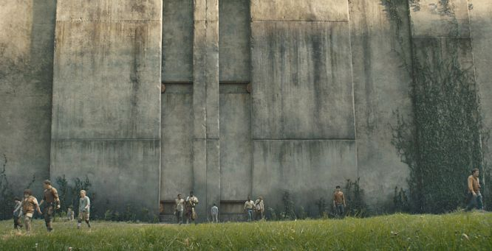
Setting can serve as a backdrop for the characters.
The air felt perfect, and it made him wonder again about the weather of the place. Never rained, never snowed, never got too hot or too cold. If it weren't for the little fact that they were torn apart from friends and families and trapped in a Maze with a bunch of monsters, it could be paradise.
- The Maze Runner by James Dashner

Slide 7
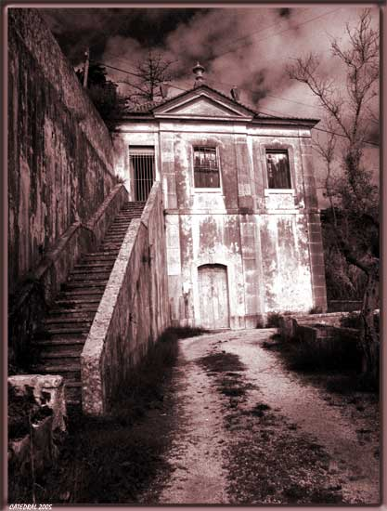
Setting can tell readers about the characters and plot.
“During the whole of a dull, dark, and soundless day in the autumn of the year, when the clouds hung oppressively low in the heavens, I had been passing alone, on horseback, through a singularly dreary tract of country.”
- “The Fall of the House of Usher” by Edgar Allan Poe

Slide 8
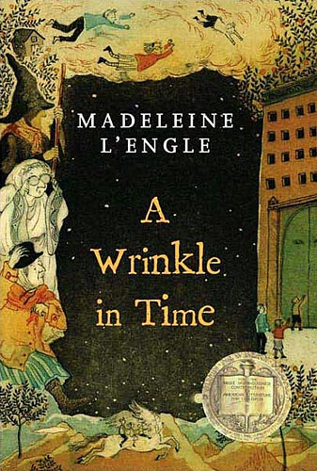
Setting can be used to create a mood or an atmosphere.
It was a dark and stormy night. In her attic bedroom, Margaret Murry, wrapped in an old patchwork quilt, sat on the foot of her bed and watched the trees tossing in the frenzied lashing of the wind. Behind the trees, clouds scudded frantically across the sky. Every few moments the moon ripped through them, creating wraithlike shadows that raced along the ground. The house shook.
- A wrinkle in Time by Madeleine L’Engle

Slide 9
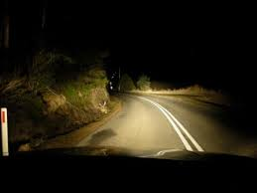
What could a possible topic be to describe this picture?

Slide 10
“Night Drive”

