Slide 2
Some things to consider…
What is an identity? What makes us who we are?
What is class?
the system of ordering a society in which people are divided into groups based on perceived social or economic status

Slide 3
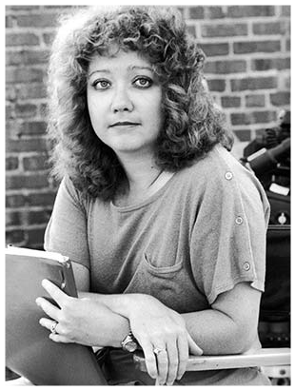
About the Author
Author: S.E. Hinton
Published in 1967
Born and raised in Tulsa, Oklahoma
Wrote it when she was sixteen years old and was the first novel she ever wrote

Slide 4
About the Author
Her novels focus primarily on teenagers and problems/issues they face (“troubled kids”)
Published books as “S.E.” so readers would not recognize the novel as being written by a female.
Notes:
Susan Eloise Hinton

Slide 5
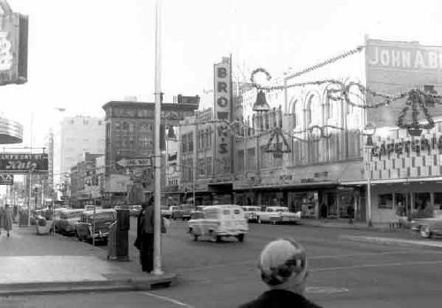
The Outsiders
Setting: 1960’s America (Oklahoma)
Our protagonists are ‘Outsiders’; they don’t fit in with society. They are judged and stereotyped.
Themes present in the novel:
Individuality & personal identity
Stereotyping & judging others
Loyalty
Youth violence

Slide 6
Characters
Greasers vs. Socs (main conflict of novel)
Ponyboy – 14-year old protagonist
Soda and Darry – Pony’s two older brothers
Their parents passed away and Darry has become the father-figure of the house

Slide 7
When answering/writing…
Mention the NAMES of the characters you are discussing
Mention the concept/idea involved
Read your answer after writing it, and ask yourself:
“Do I need to look at the question to understand the answer?”

Slide 8
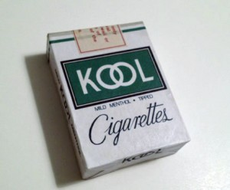
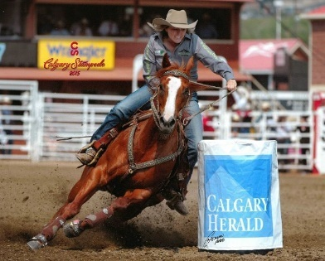
Vocabulary Words
Hood – a kid from the East side (same as a Greaser). The difference is that a hood is a ‘bad’ kid who steals, kills, and is a criminal.
Kools – a brand of cigarettes
3. Barrel Race – a rodeo event where the person races around barrels on their horse (generally an event for women)

Slide 9
Vocabulary Words
4. Heater – a gun
5. Cooler – jail
6. A weed – a cigarette
7. Gallant – a person who is calm and unflinching in a battle. Also, they are selfless and noble.

