Slide 1
Theme

Slide 2
What is the theme of a story?
THEME:
What the reader learns about life as they read the story.
What does the novel say about life and people?
What is the author’s message?
What is the BIG idea?

Slide 3
Theme vs. topic
Topic
Theme
A matter dealt with in a text. Something that is present in the story.
Examples of TOPICS
Love
Family
Racism
What the author is saying ABOUT the topic.
Examples of THEMES
Love, if taken to extremes, can be more negative than positive.
Love can conquer even the greatest evil.
Family is the most significant influence in shaping who a person becomes.
Racism is a major cause of injustice in society.

Slide 4
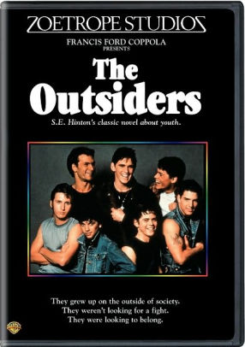
Theme Statement
STEP ONE: Choose story to examine (The Outsiders)
STEP TWO: Create a list of topics in the story (Class, identity, innocence, loyalty, violence)

Slide 5
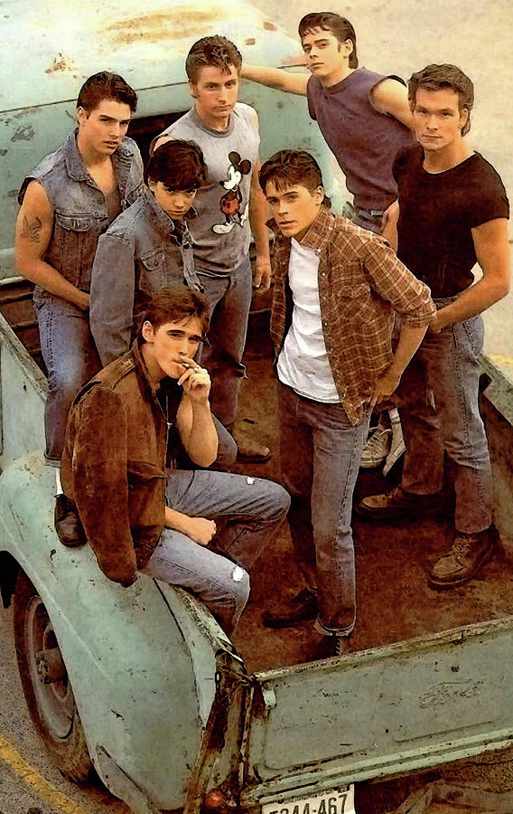
Theme Statement Cont.
STEP THREE: Write a sentence that begins with “the author believes that…” This statement should state what the author believes about the topic.
The author believes that violence is pointless and only causes more harm than good.
The author believes that loyalty is an extremely important aspect of human relationships.
***NOTE: THE THEME STATEMENT SHOULD NOT REFERENCE THE STORY IN ANY WAY. This is what the author is saying about the world in general.
STEP FOUR: Remove “the author believes that”
The author believes that Violence is pointless and only causes more harm than good.

Slide 6
Violence is pointless and only causes more harm than good.
FINAL THEME STATEMENT
*This is one of the many theme statements that could be applied to The Outsiders

Slide 7
Build theme statement together!

Slide 8
Finding Nemo
Make a list of topics:

